Slide 1
The tourism system
The Lapier Tourism System and other tourism systems

Slide 2
Components of Tourism System
Attractions: Natural and man made
Accessibility: Surface and and water transport
Accommodation: Serviced and self-catering
Amenities: Extra services
Activities

Slide 3
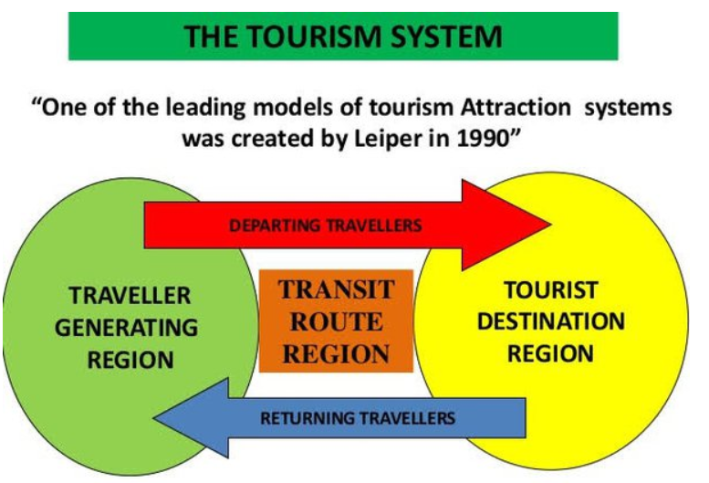
The Tourism System

Slide 4
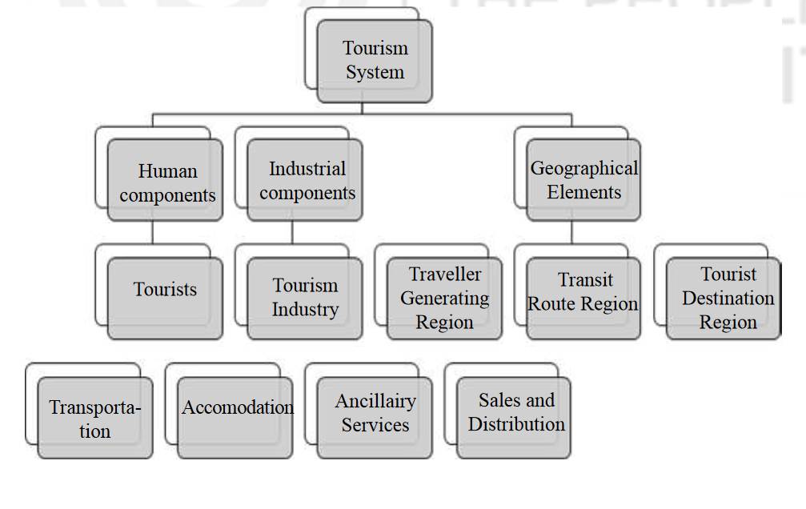
Lapier Tourism System

Slide 5
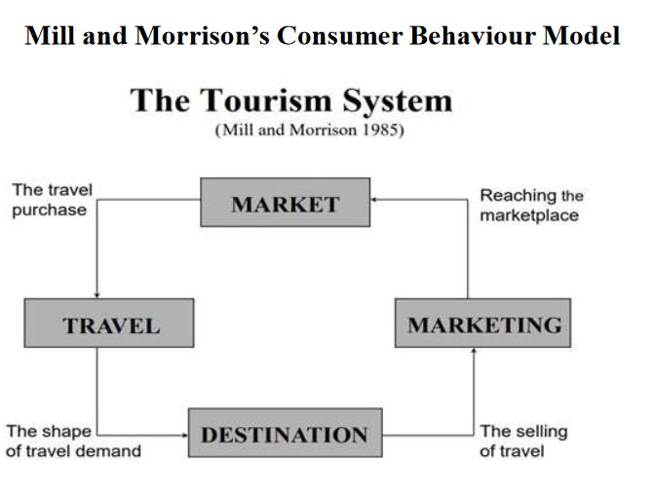
The Tourism System 1

Slide 6
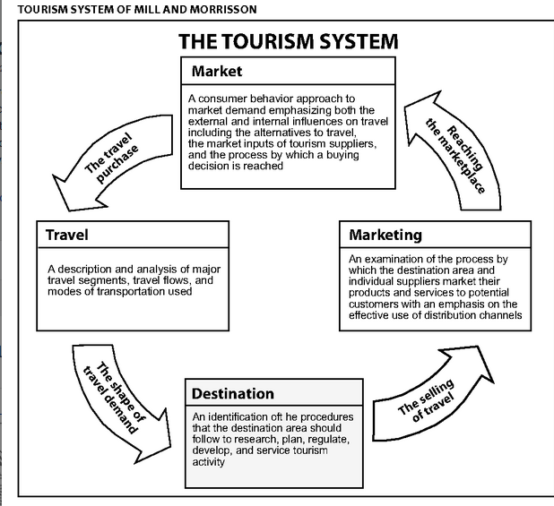
The Tourism System 1

Slide 7
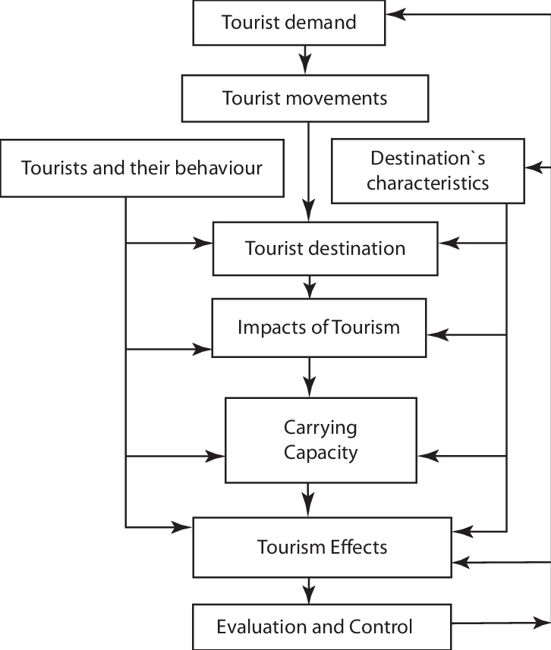
Mathison and Wall 2006

